Slide 1




Notes:
*

Slide 2


UI ENGINEERING STUDIO
UI Engineering Studio. Day 1 Bootcamp: Git

Slide 3

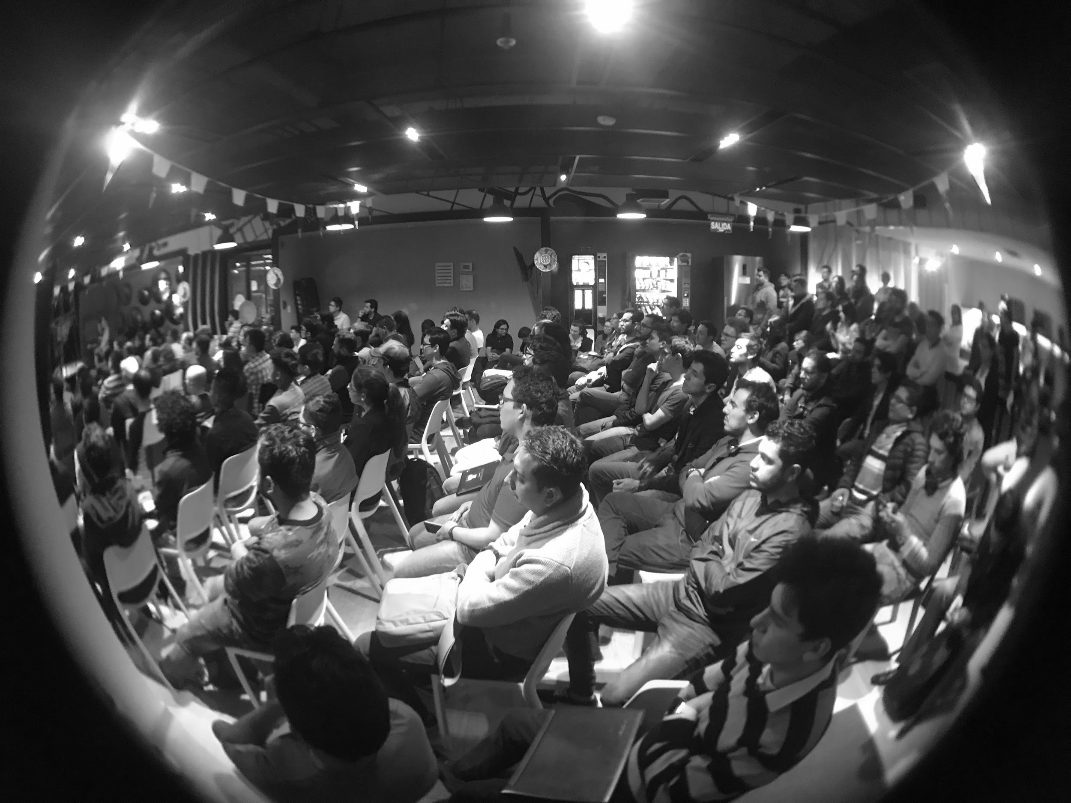
UI ENGINEERING STUDIO
Git
Git is a free and open source distributed version control system designed to handle everything from small to very large projects with speed and efficiency.
- git-scm.com
Version Control
Git Commands
Branching Strategy
Pull Requests

Slide 4
UI ENGINEERING STUDIO
UI Boot Camp: Git Version Control
Version control is a system that records changes to a file or set of files over time so that you can recall specific versions later.
- git-scm.com

Slide 5
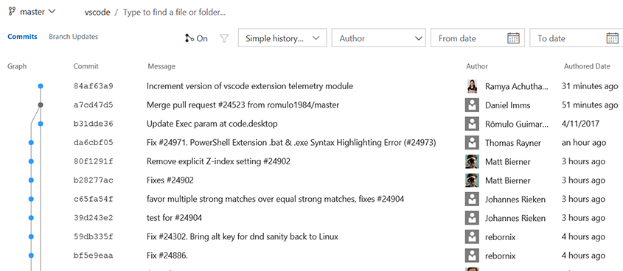
UI ENGINEERING STUDIO
UI Boot Camp: Git Version Control

Slide 6
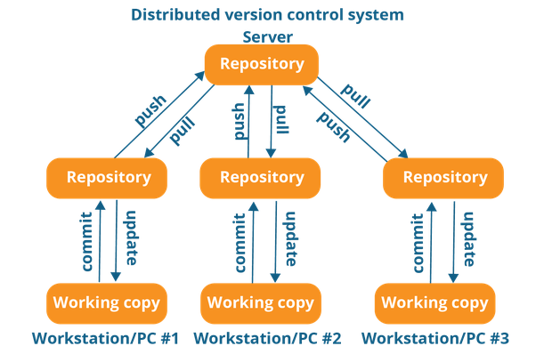
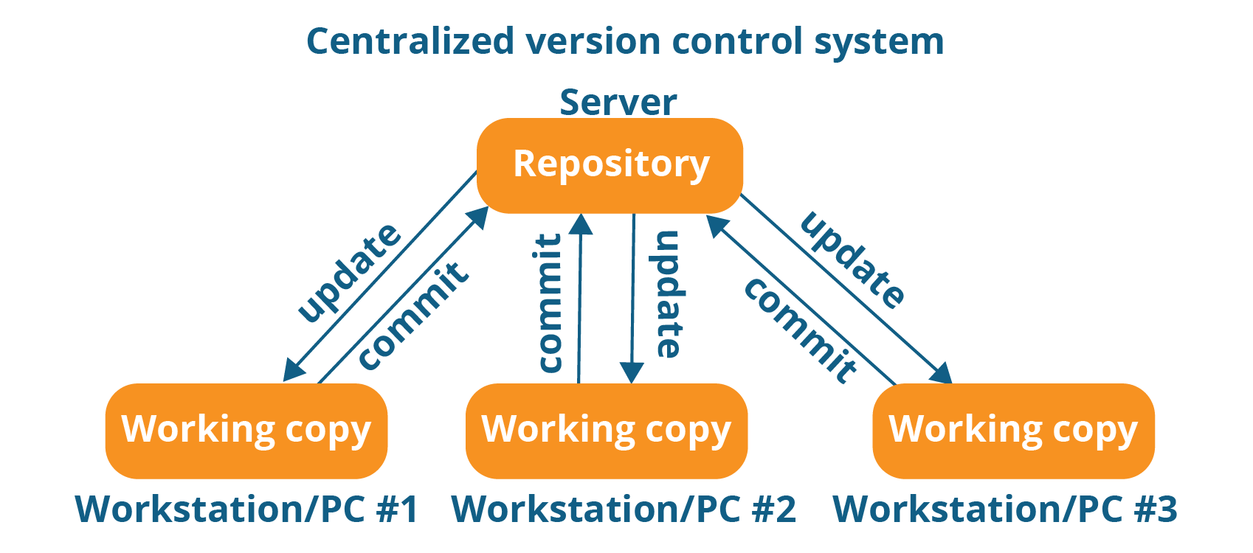
UI ENGINEERING STUDIO
UI Boot Camp: Git Version Control: Centralized vs Distributed

Slide 7
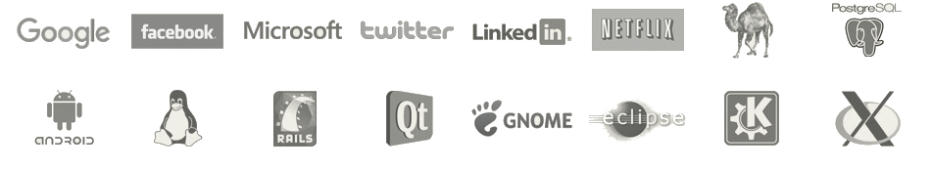
UI ENGINEERING STUDIO
UI Boot Camp: Git Projects and Companies Using Git

Slide 8



UI ENGINEERING STUDIO
UI Boot Camp: Git Git Repositories Managers

Slide 9
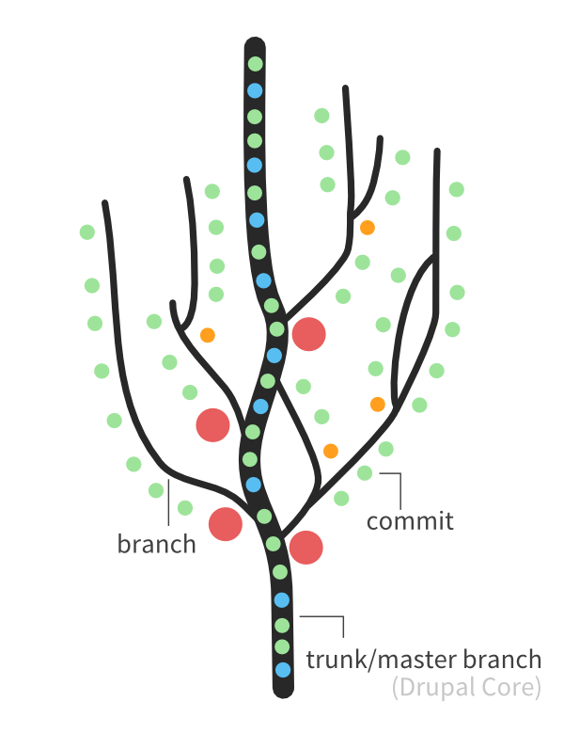
UI ENGINEERING STUDIO
UI Boot Camp: Git Repo tree

Slide 10
UI ENGINEERING STUDIO
UI Boot Camp: Git Git Commands: Starting
git init: You have a local folder and start a repo
git clone: You’re going to download a remote repo
git pull <remote> <branch_name>: Downloading the latest changes of the branch

Slide 11
UI ENGINEERING STUDIO
UI Boot Camp: Git Git Commands: Setting up
git remote add <name> <url>: Adding a new remote url
git config --global user.name “Sebas Alarcón”: Setting up commit author name
git config --global user.email “sebas.alarcon@whatever.com”: Setting up commit author email

Slide 12
UI ENGINEERING STUDIO
UI Boot Camp: Git Git Commands: Adding to stage and committing
Change whatever you need to change
Check if you have local changes git status: Showing which files were added, removed or changed

Slide 13
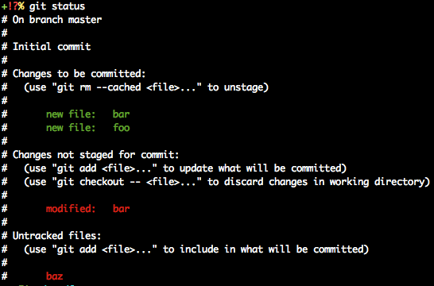
UI ENGINEERING STUDIO
UI Boot Camp: Git Git Commands: Adding to stage and committing

Slide 14
UI ENGINEERING STUDIO
UI Boot Camp: Git Git Commands: Adding to stage and committing
3. Check if the changes that you have are correct git diff: Showing the current changes of each file

Slide 15
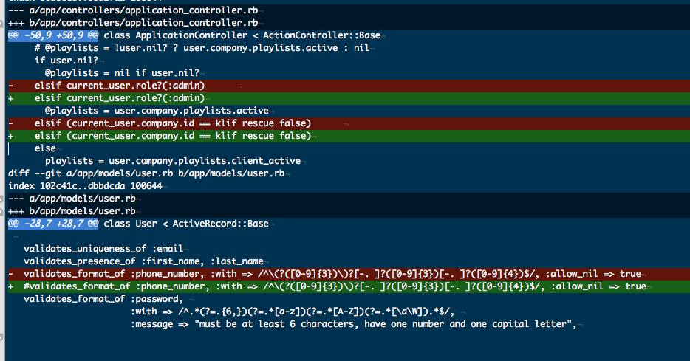
UI ENGINEERING STUDIO
UI Boot Camp: Git Git Commands: Adding to stage and committing

Slide 16
UI ENGINEERING STUDIO
UI Boot Camp: Git Git Commands: Adding to stage and committing
4. Stage your changes git add <files>: Staging your changes. Remember the . and -A options
5. Commit your changes
git commit -m “This is the commit message”
git commit

Slide 17
UI ENGINEERING STUDIO
UI Boot Camp: Git Git Commands: Adding to stage, committing and pushing
6. Push your changes
git push <remote> <branch_name>

Slide 18
UI ENGINEERING STUDIO
UI Boot Camp: Git Git Commands: Creating and deleting a branch
Create the branch git checkout -b <your_new_branch>
Check if everything is ok git branch
You can delete the branch by using git branch -d <your_new_branch>

Slide 19
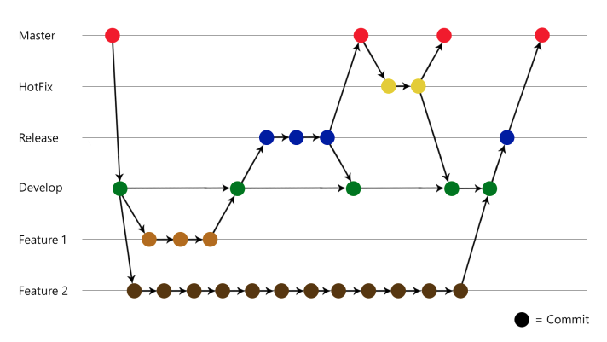
UI ENGINEERING STUDIO
UI Boot Camp: Git Branching Strategy

Slide 20
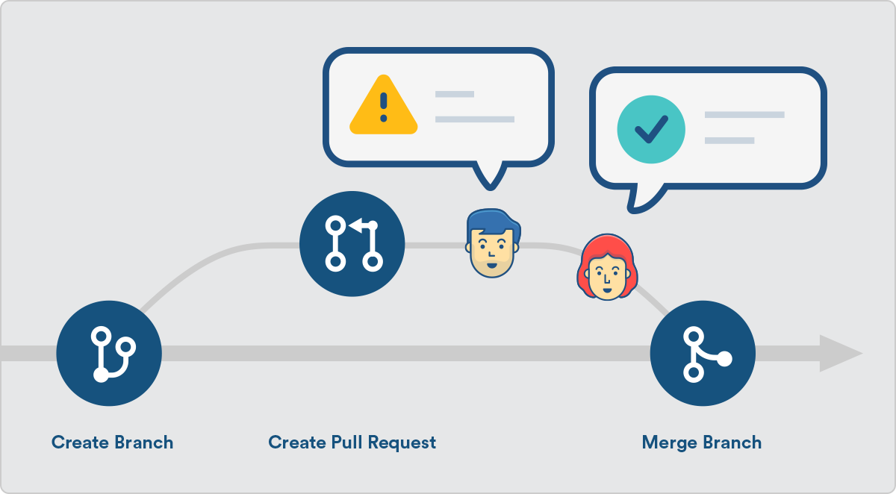
UI ENGINEERING STUDIO
UI Boot Camp: Git Pull Requests

Slide 21
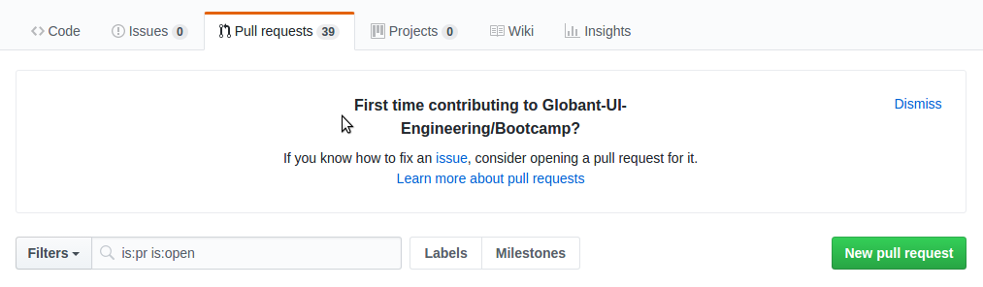
UI ENGINEERING STUDIO
UI Boot Camp: Git Pull Requests

Slide 22
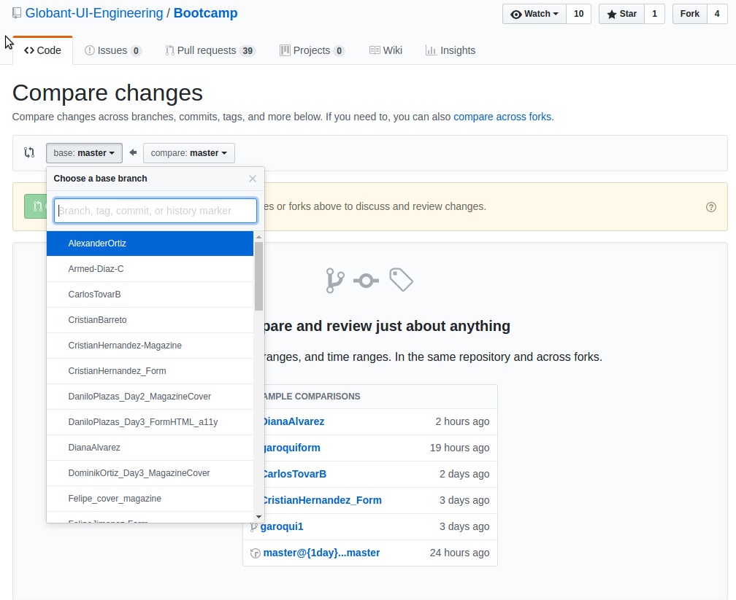
UI ENGINEERING STUDIO
UI Boot Camp: Git Pull Requests

Slide 23
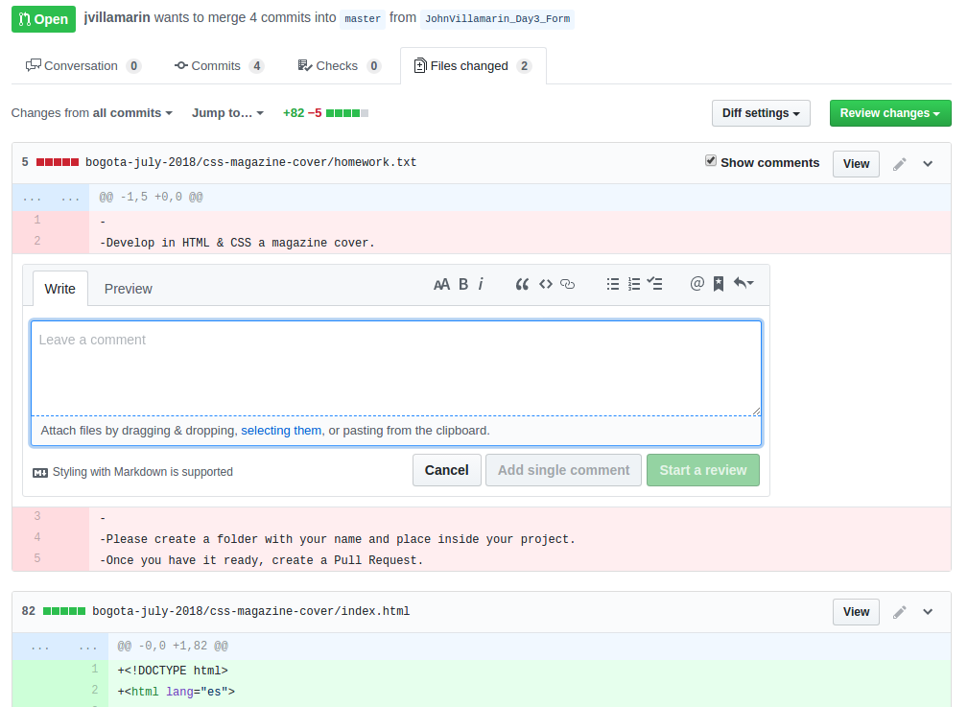
UI ENGINEERING STUDIO
UI Boot Camp: Git Pull Requests

Slide 24
Notes:
*

Slide 25
UI ENGINEERING STUDIO
UI Boot Camp: Git Homework: Research and understand
git tags
git rebase vs git merge
git fetch
Git shortcuts

